Slide 1
CMIS CASE COMPETITION MaysCentral Event Management System
Sonali Dash
Ritik Ashok Manghani
Sri Akhil Arigela
Yashas Suresh

Slide 2
PROBLEM STATEMENT
Fragmented Registration Process Pain Point:
Registrations are done through Google Forms.
Data is copied manually into spreadsheets.
Students don’t receive confirmations, leading to confusion.
Prototype Solution:
Unified event registration page
Instant confirmation + email
Seat availability shown in real time
Auto-added to personal calendar (Google/Outlook/ICS export)

Slide 3
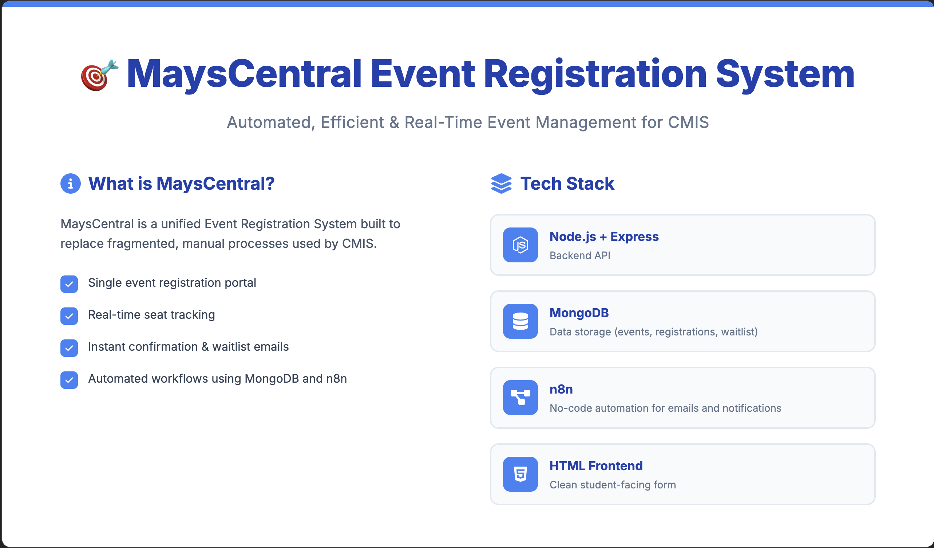
Advanced ETL Orchestration
ETL Overview
Current pipeline generates synthetic product data using Python
Data cleaned and transformed before loading into MariaDB
Vector embeddings generated using MiniLM for semantic search
New goal: Scale pipeline using orchestration (Airflow)

Slide 4
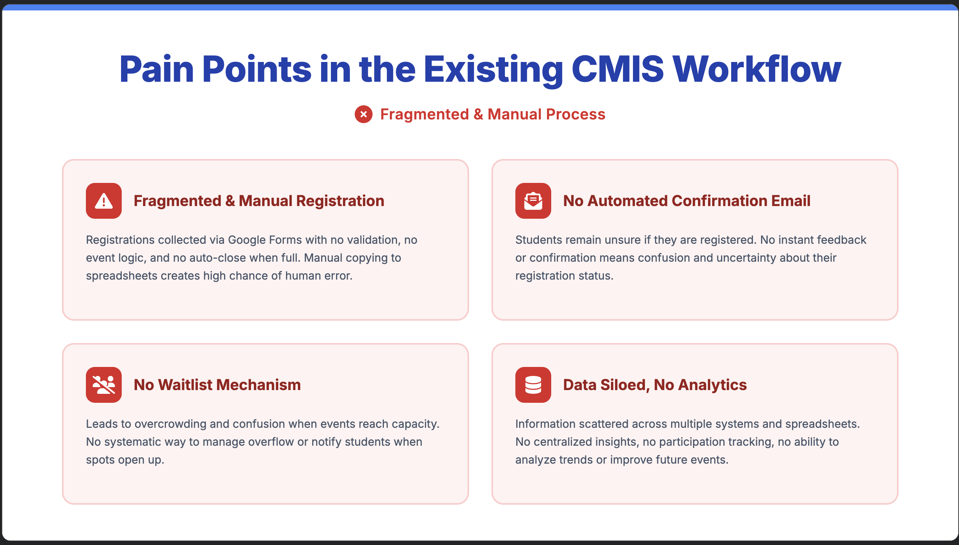
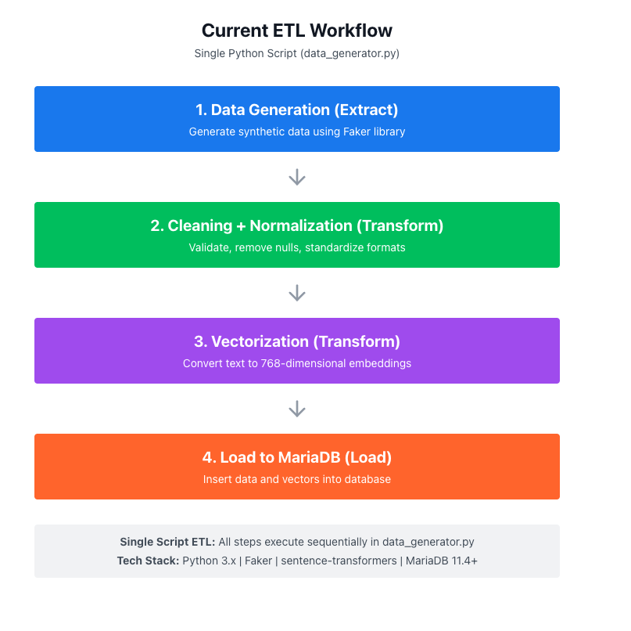
Current ETL Workflow

Slide 5
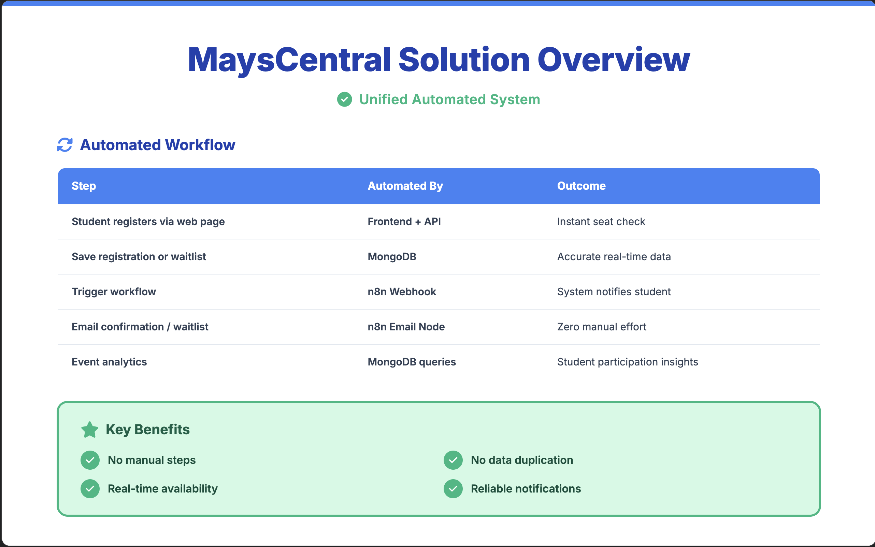
Why is orchestration needed?
Limitation of Script | Benefit of Orchestration
No scheduling | Time-based & event-driven runs
No retry logic | Automatic retries with backoff
Hard to debug failures | UI-based logs + alerting
No pipeline visibility | DAG dependency visualization
Manual execution | Fully automated

Slide 6
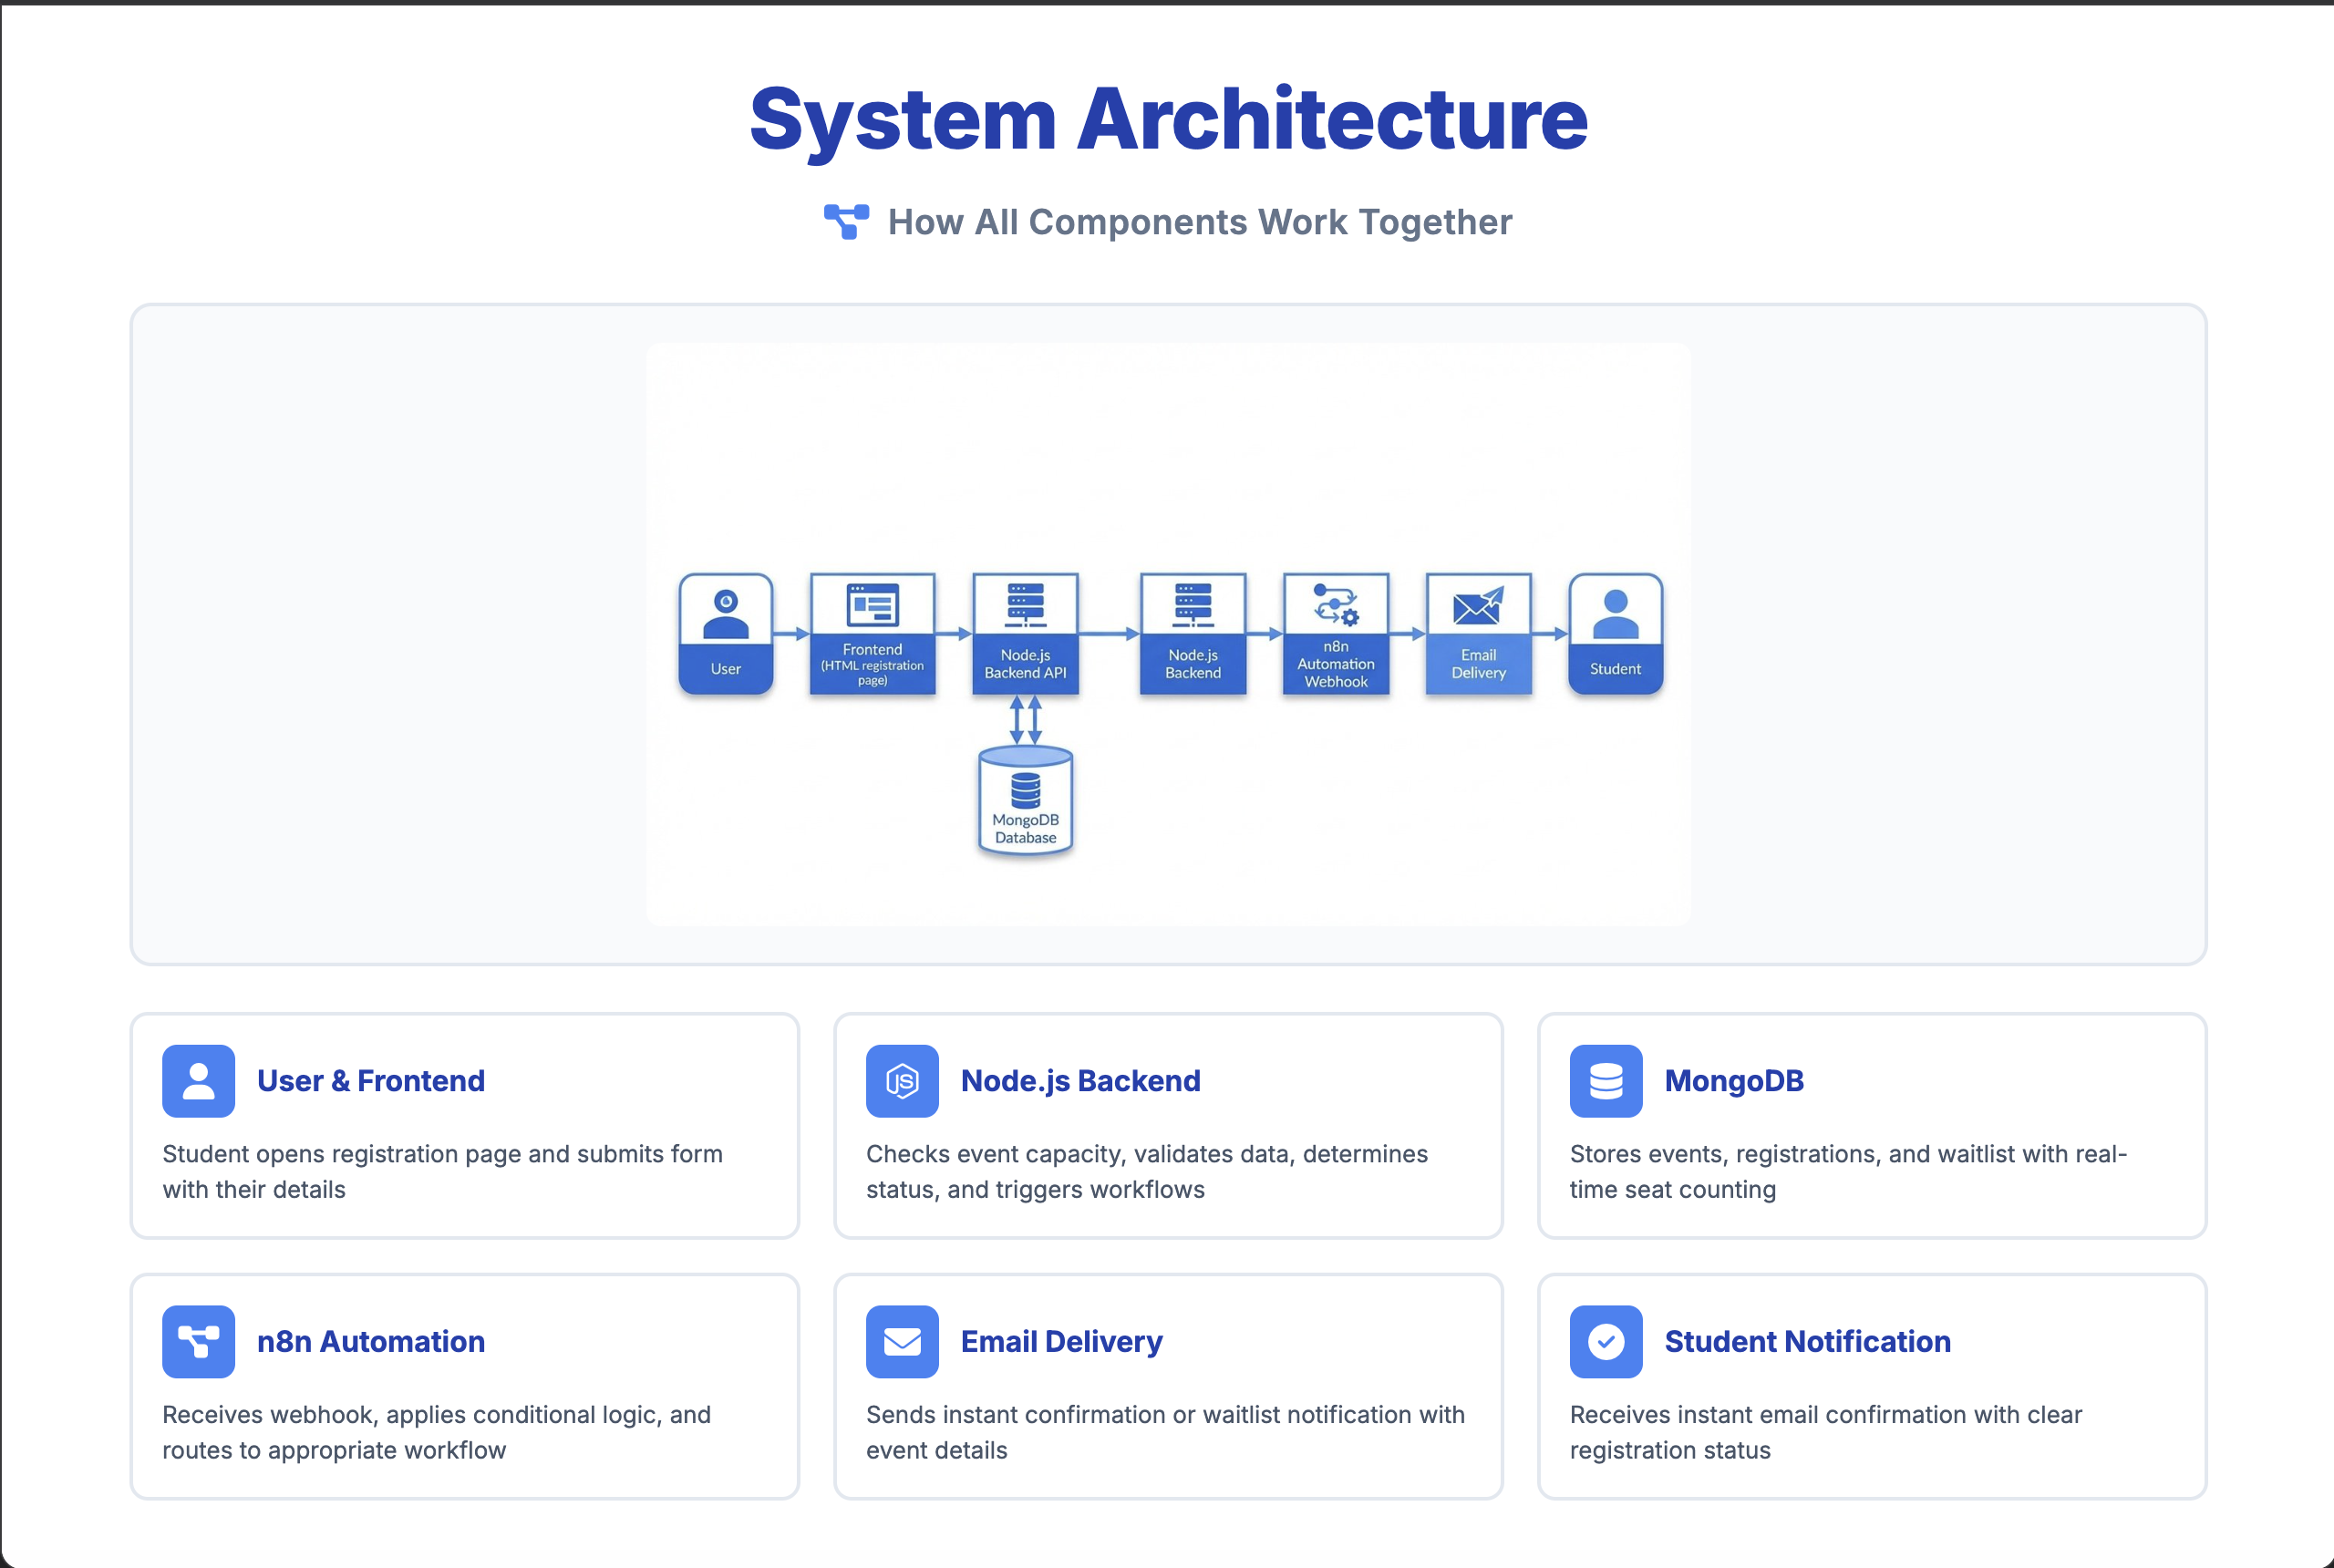
Proposed Airflow-Based Architecture

Slide 7
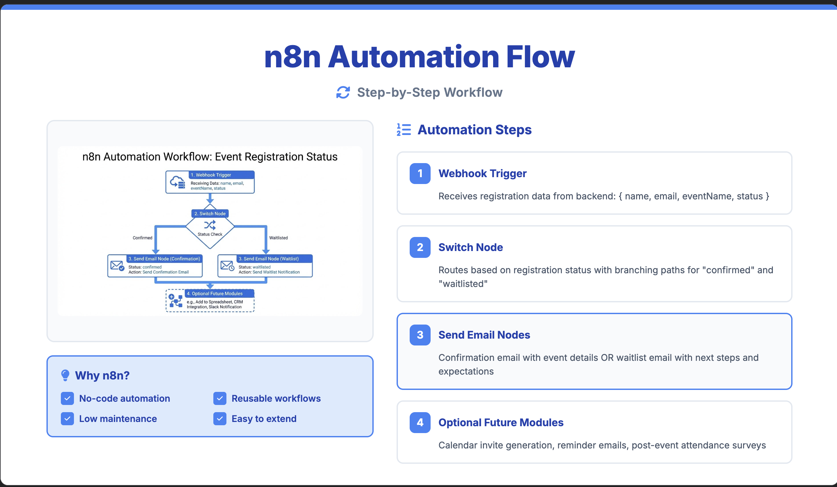
Error handling and logging

Slide 8
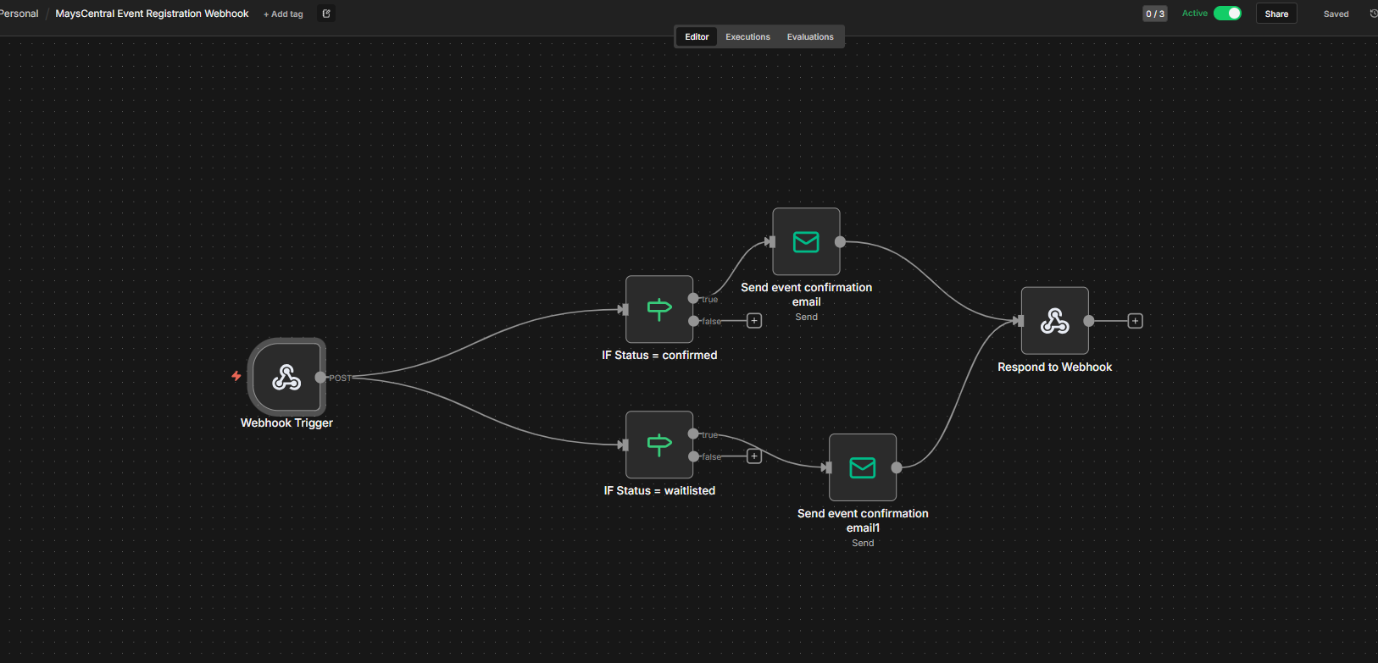
Monitoring & Observability
N8N Configuration for Automated CMIS Event Registration
Airflow UI provides run logs and execution history
Integration with Prometheus + Grafana for metrics
Pipeline KPIs tracked:
record throughput
failed inserts
embedding generation latency

Slide 9
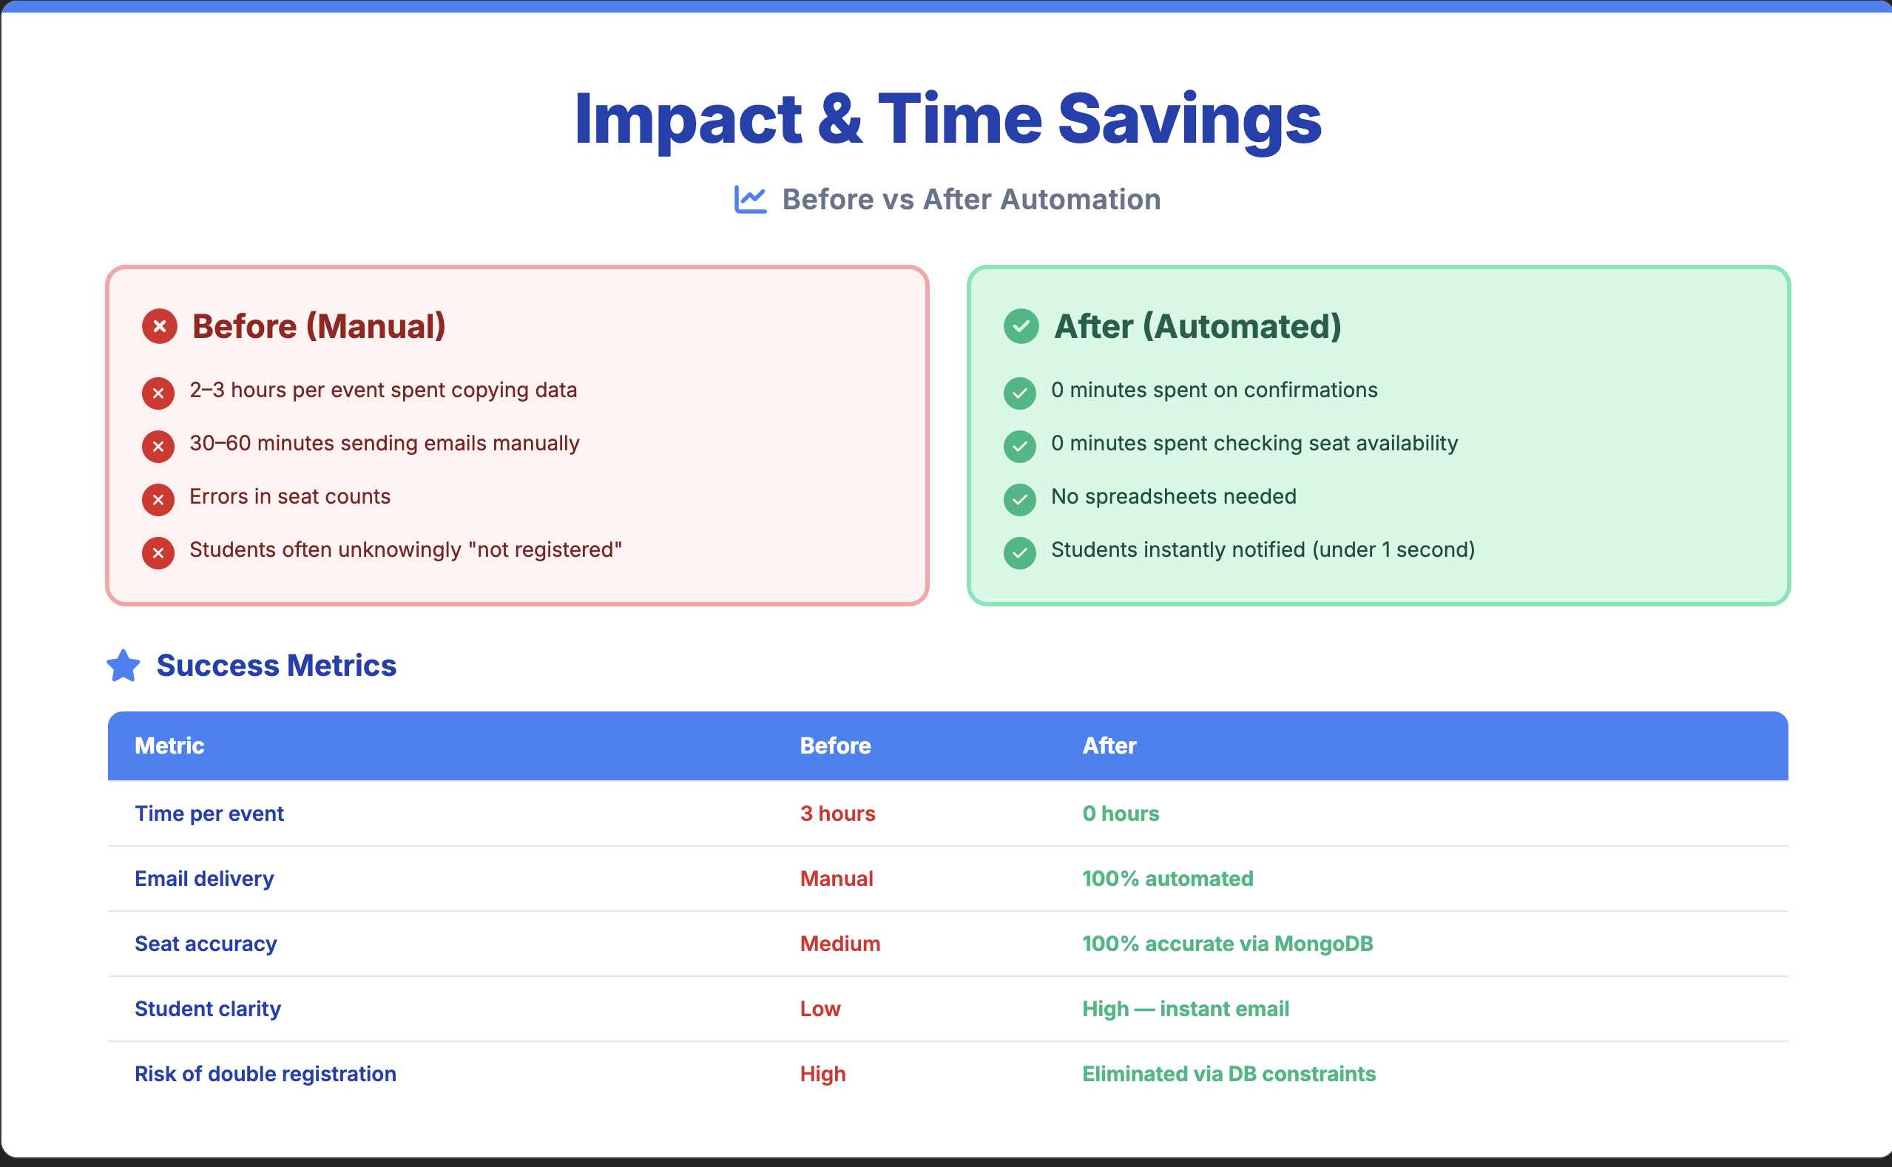
Sample Airflow DAG Code

Slide 10
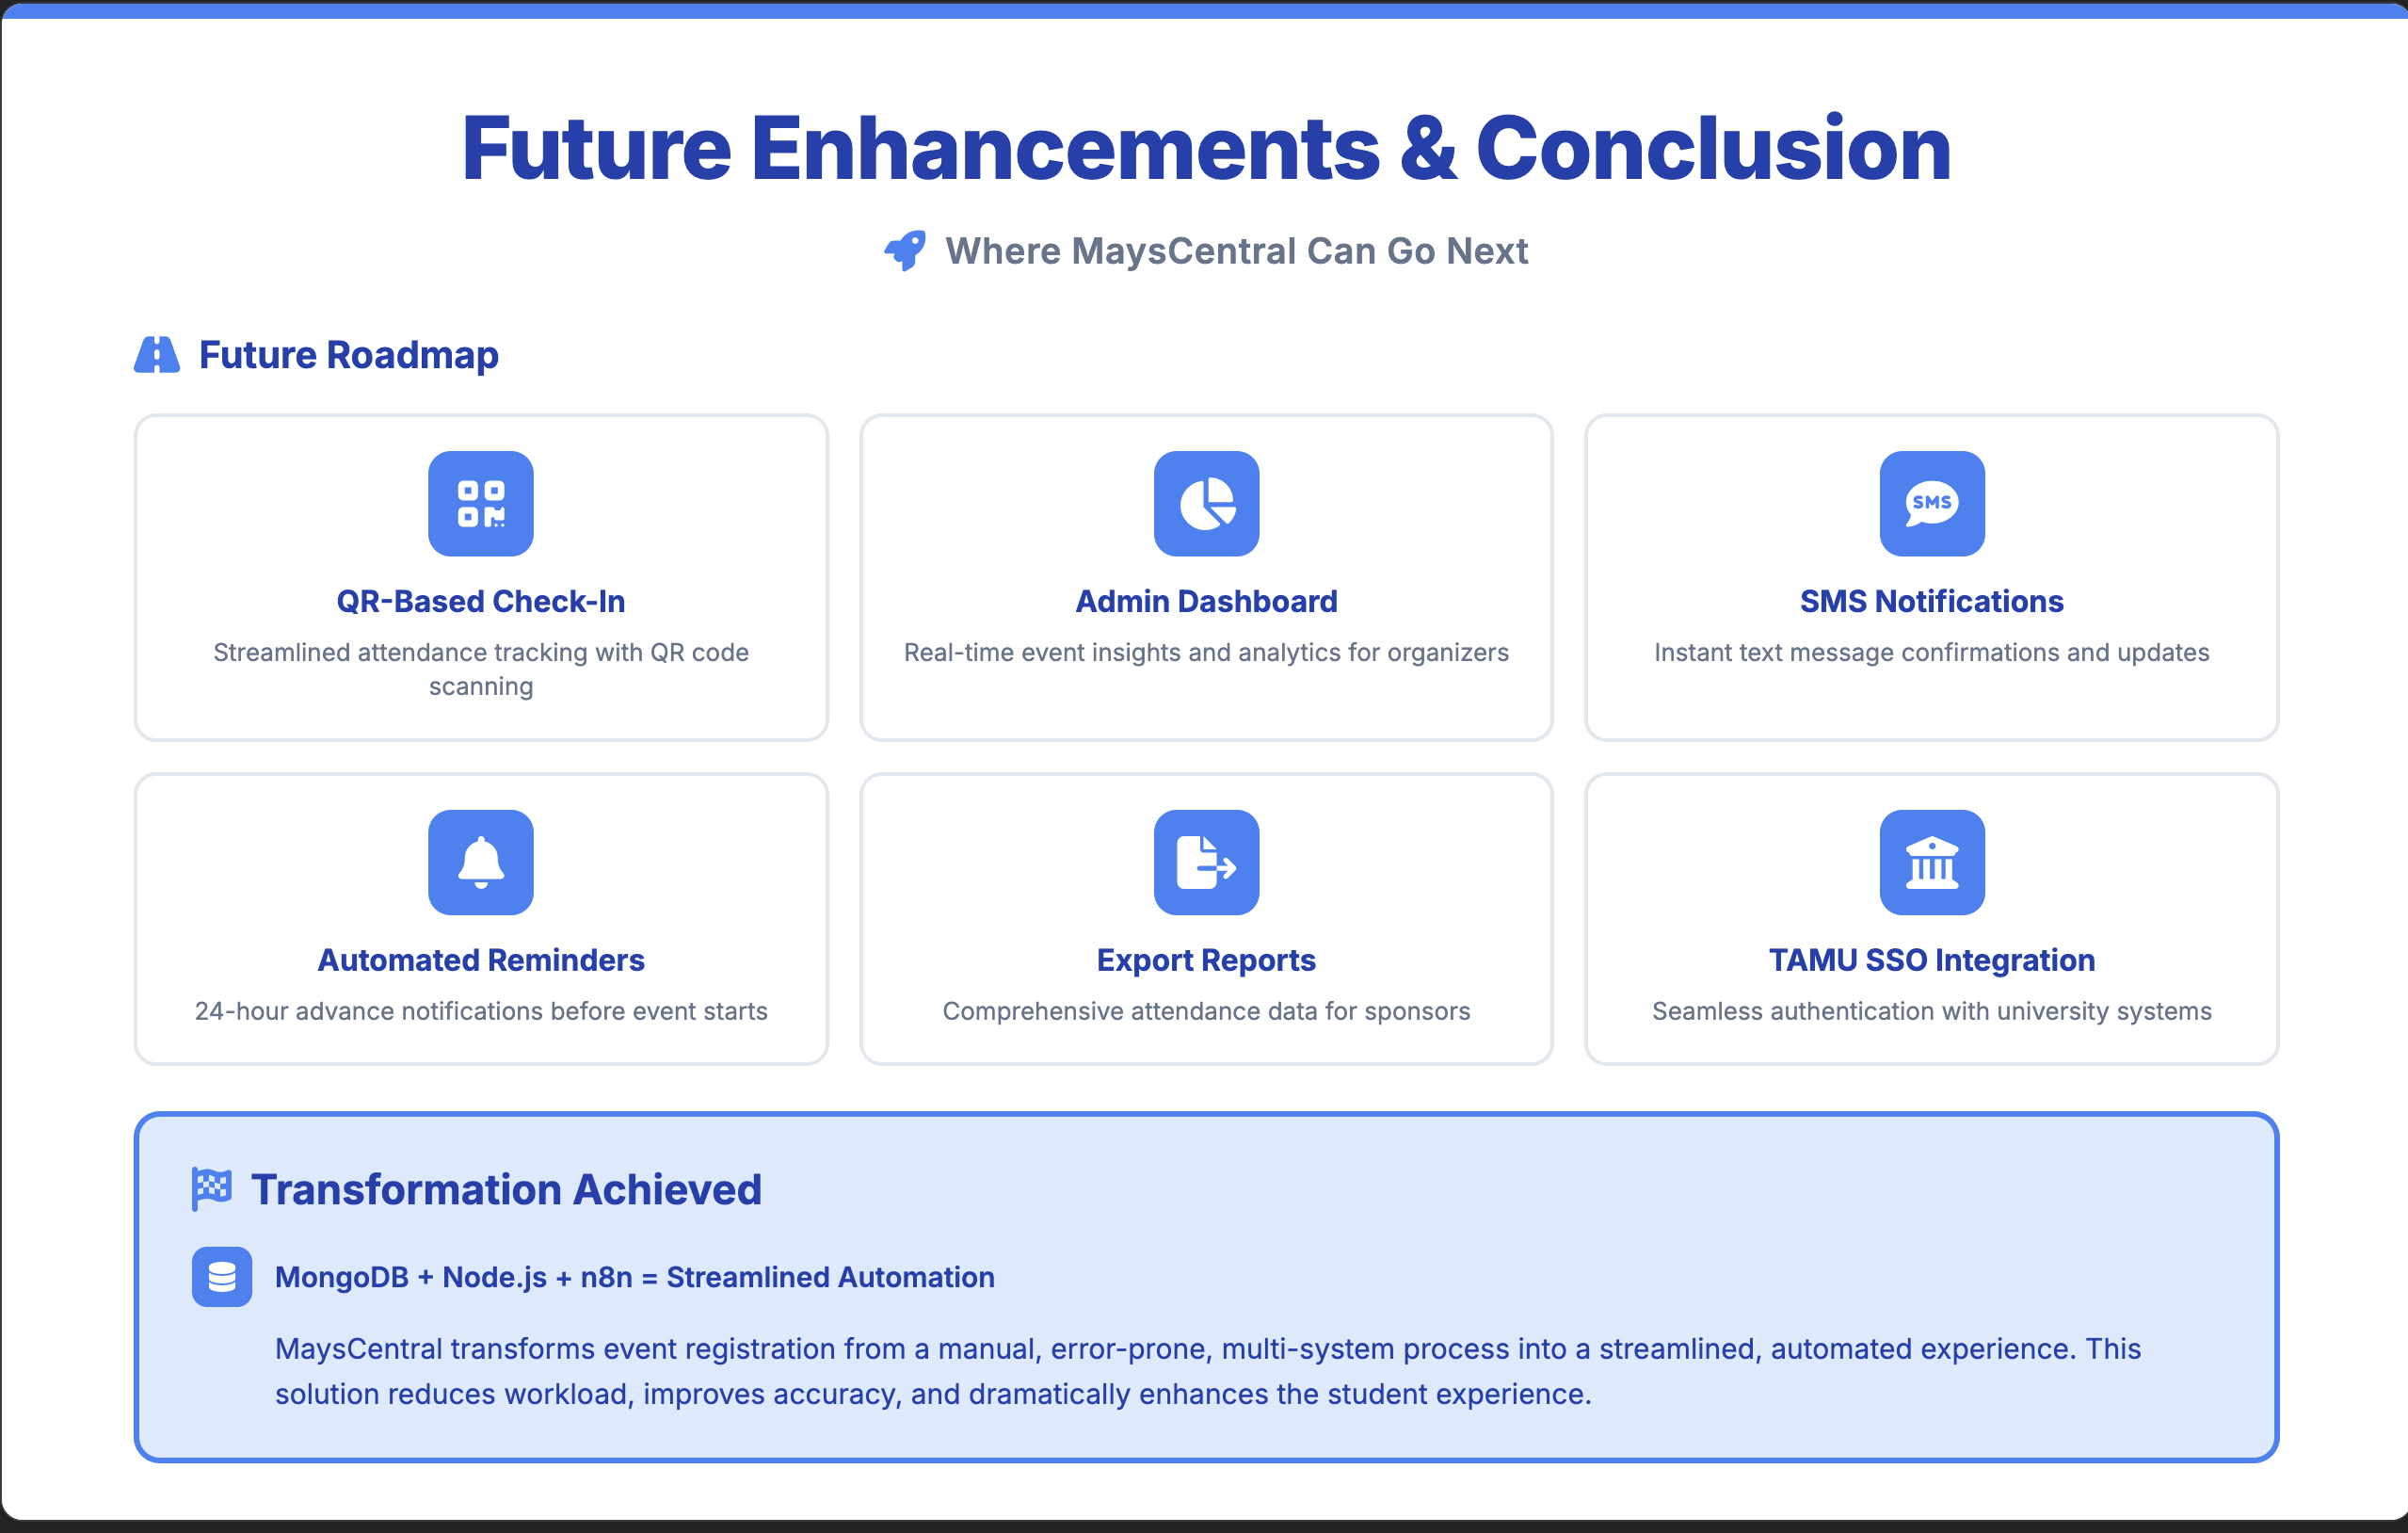
Monitoring & Observability
Airflow UI provides run logs and execution history
Integration with Prometheus + Grafana for metrics
Pipeline KPIs tracked:
record throughput
failed inserts
embedding generation latency

Slide 11
THANKS
Gig 'em

